Slide 1

SPACE ALLOCATION TECHNIQUES
Design Optimization Toolset (DOTS)
Dr. Nirvik Saha, Ph.D., Post-Doctoral Fellow at Rensselaer Polytechnic Institute
Dennis Shelden, Ph.D., AIA, Associate Professor, School of Architecture, Georgia Institute of Technology, currently Director of Center for Architecture Science and Ecology, Rensselaer Polytechnic Institute
John Haymaker, AIA, Ph.D., Director of Research at Perkins and Will

Slide 2
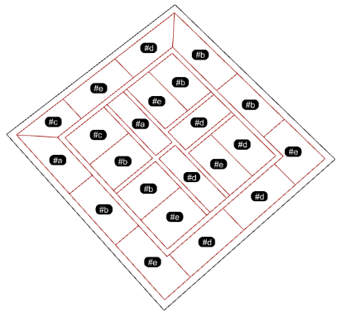
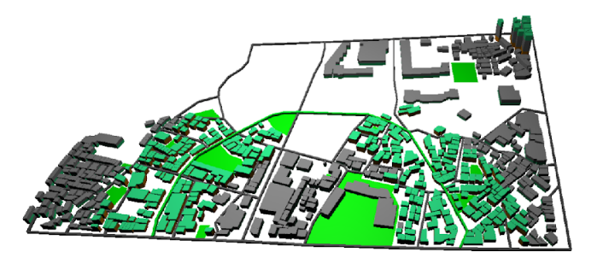
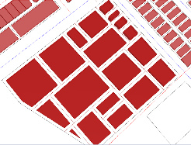
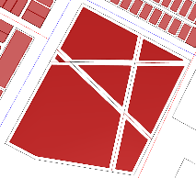
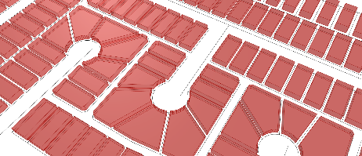
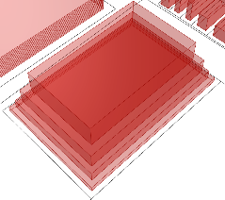
Space Allocation Techniques (SAT)
Framework
Integrate
Connected Methods
general class of Constrained-Problems
Spatial organization
Parcellation-Massing
Site Feasibility Study
Spatial Networks
employed in numerous design processes, across scales
Floor
Site
City-Blocks
Floor Plans
Site Plan & massing
Space-Activity Networks of City-blocks

Slide 3
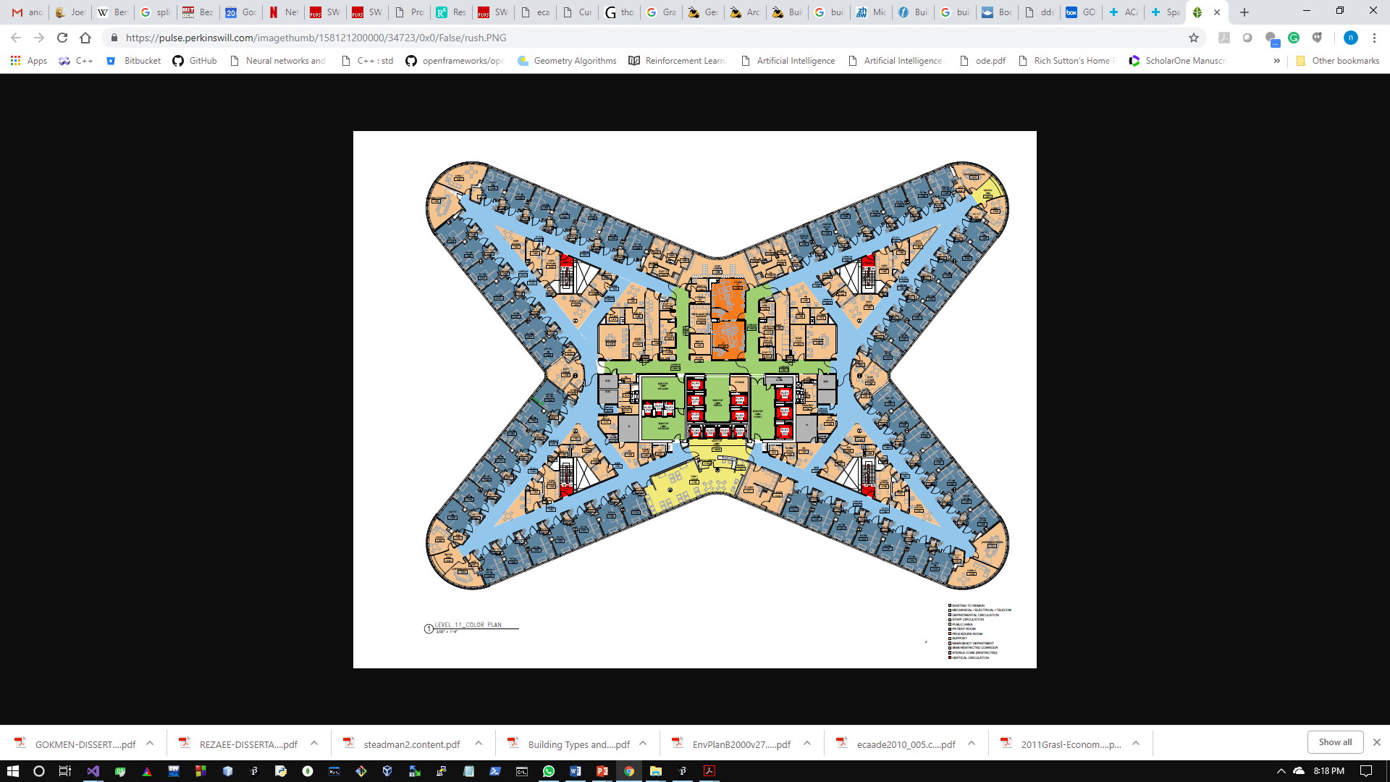
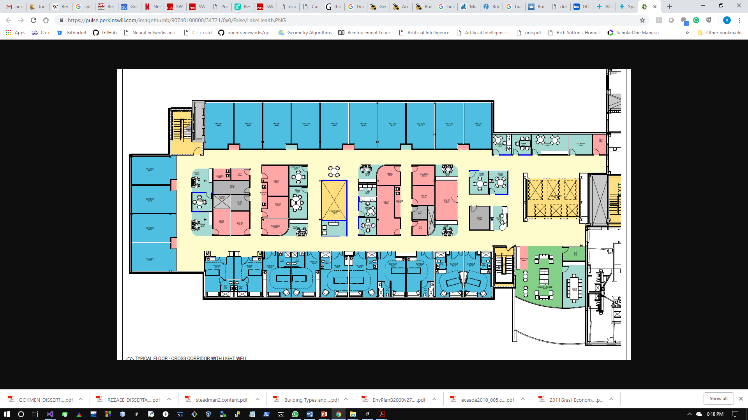
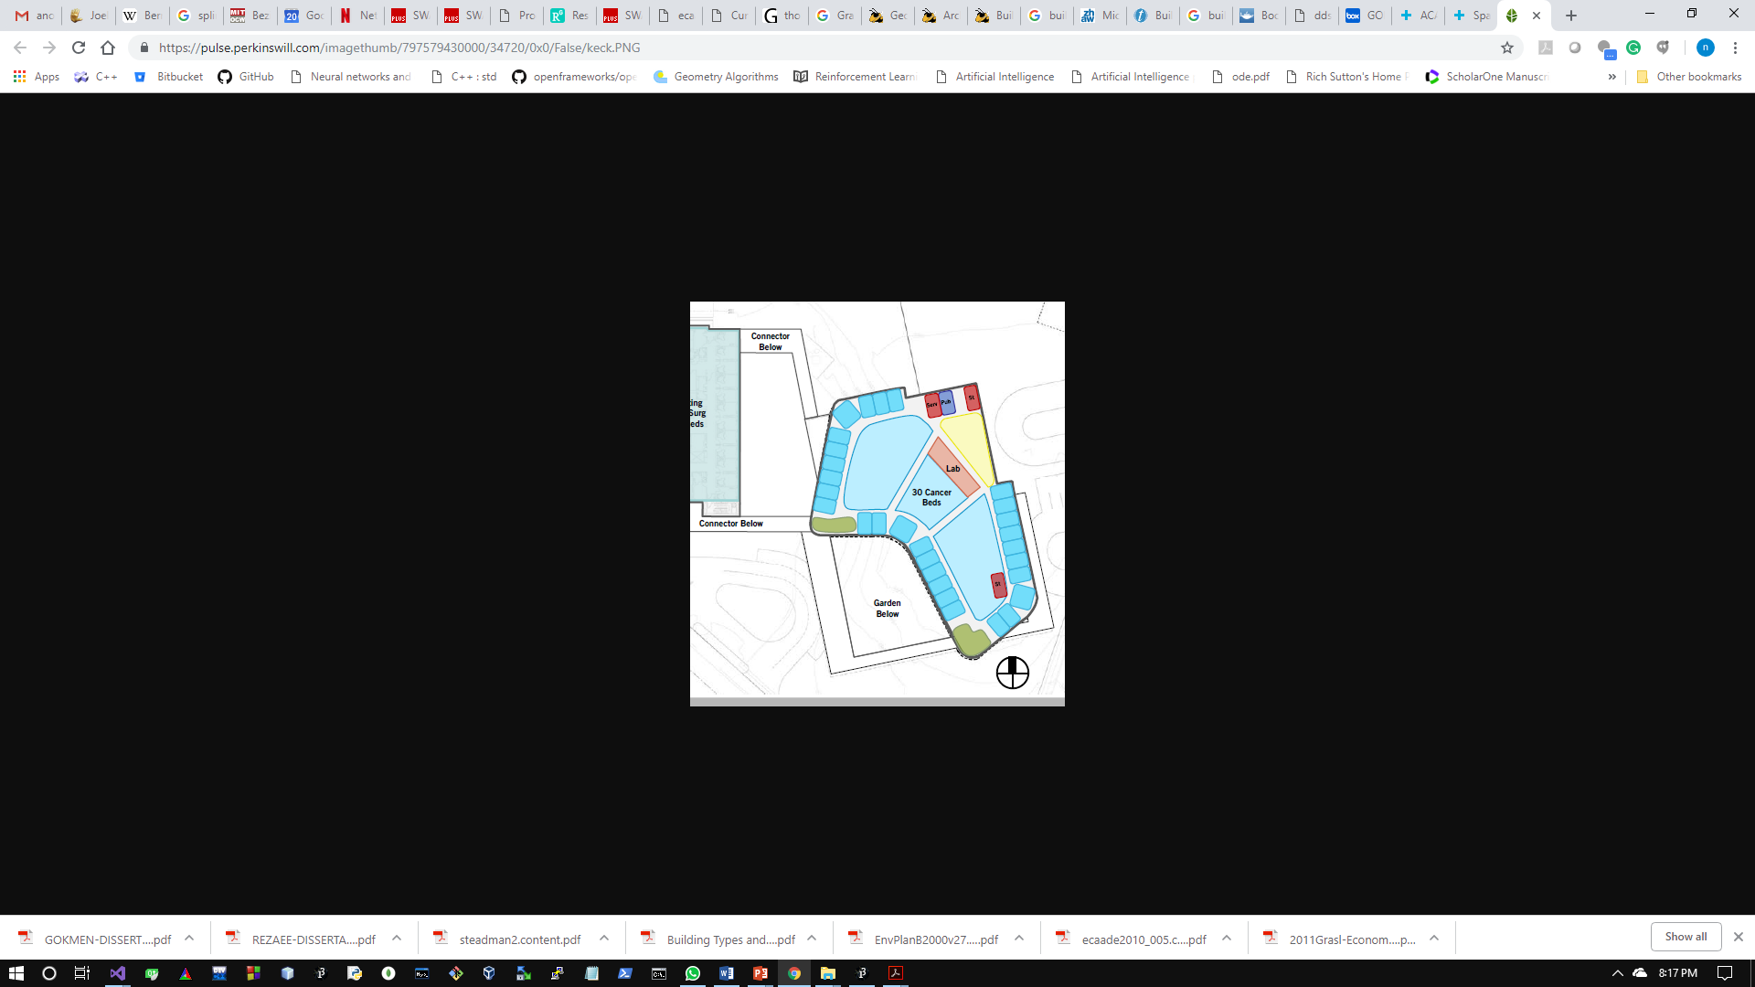
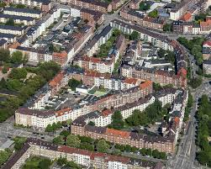
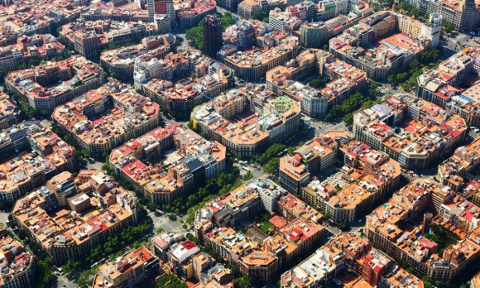
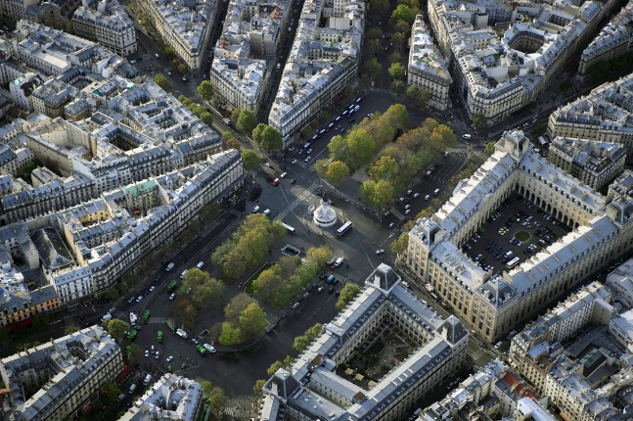
Patterns: generalize – form / task
SAP extensions
Common Class of Problems
Geometric forms
Optimization techniques
Generalization – scales & domains
Optimization Modules: Algebraic forms + Reinforcement Learning
NP complete problem, 5!=120, 10! = 3.6M+; 14!=87B+; 15!=1.3076744e+12
Patterns in organization of spaces: i) along the periphery ii) subdivision of internal region.
Building floor plans
Satellite images of Barcelona, Paris, and Berlin

Slide 4
Embedded structures
Explicit design process
Exploration
Semi-automation
SAT
Optimize
SAT Generate
Models (M_{0-n})
Design problems
Geometric Forms
Organize relationships
SAP
Model-1
Model-2
workflow
workflow
Linked- multiple models

Slide 5
Environment
Agent
State
Action
Reward
Action-Value Function
Policy
LEARNING
Reinforcement Learning
Value Iteration: V*(s)=max[R(s,a) + ˠΣ p(s’ | s,a) V*(s’)] using the algorithm:
For all states (s) :
For all actions (a):
Q(s,a)<-R(s,a) ˠΣp(s’|s,a)V*(s’)
V(s) <- max(Q(s,a)
Until V(s) converges, where, convergence is given by: |V(t+1)-V(t)|<є
Policy iteration: 𝚷*(s)=max[R(s,a)+ˠΣp(s’|s,a)V^{𝚷}(s’)]
Initialize 𝚷’ arbitrarily
Loop:
Compute V(s) for 𝚷(s) policy: V_{𝚷}= R(s,𝚷(s))+ˠΣp(s’|𝚷(s,a)) V_{𝚷}(s’)]
Improve policy at each state: 𝚷’(s)=argmax([R(s,a)+ˠΣp(s’|𝚷(s,a)) V_{𝚷}(s’)]
Until convergence: |𝚷(s)-𝚷’(s)|<є
Q-learning:Q*(s,a)=max[R(s,a)+ˠΣp(s’|s,a)V^{𝚷}(s’)]
Initialize discounted factor ˠ, learning rate ∝, transition matrix R+Q(s,a)=0-matrix.
For each episode(agent goes from starting state to final state):
Select a random initial state
Do while(terminal state is not reached):
Select action a for current state s
Use this action a to go to next state s’
Calculate max Q(s’,a’) value for next state s’
Q(s’,s)=Q(s,a)+∝[R(s,a)+ˠ max[(Q(s’,all actions) - Q(s,a)]]
Set next state as s’ and current state=s, s’=s
End do
End episode
Q-learning is the most popular.
The equation to maximize Q-value is given by: Q(s,a)=(1-∝)Q(s,a)+∝[R(s,a)+ˠ max(Q(s’,a)]

Slide 6
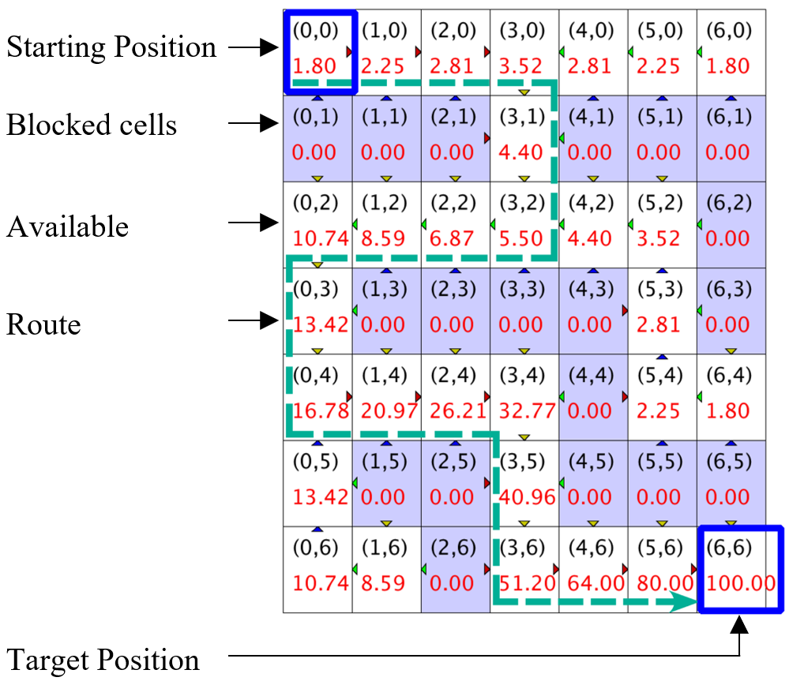
Initialize Q matrix with elements set at 0
Discounted rewards Reward: R(s,a)
R(s,a)+∑_{(i=1)}^{T}γ^{(i-1)}R_{i} (where 0<γ<1, let γ=0.8)
Set of states s_{i}: {(0,0, (0,1), (0,2), …, (6,5), (6,6)}
Set of actions a_{i}: {up, down, left, right}
s
Initial State
P
Policy
a
Action
p
Probability
r
Reward
s’
New State
Q matrix
States (x,y) | 0 | 1 | 2 | 3 | 4 | 5 | 6
0 | 1.80 | 2.25 | 2.81 | 3.52 | 2.81 | 2.25 | 1.80
1 | 0.00 | 0.00 | 0.00 | 4.40 | 0.00 | 0.00 | 0.00
2 | 10.74 | 8.59 | 6.89 | 5.50 | 4.40 | 3.52 | 0.00
3 | 13.42 | 0.00 | 0.00 | 0.00 | 0.00 | 2.81 | 0.00
4 | 16.78 | 20.79 | 20.21 | 32.71 | 0.00 | 2.25 | 1.80
5 | 13.42 | 0.00 | 0.00 | 40.96 | 0.00 | 0.00 | 0.00
6 | 10.74 | 8.59 | 0.00 | 51.20 | 64.00 | 80.0 | 100.00

Slide 7
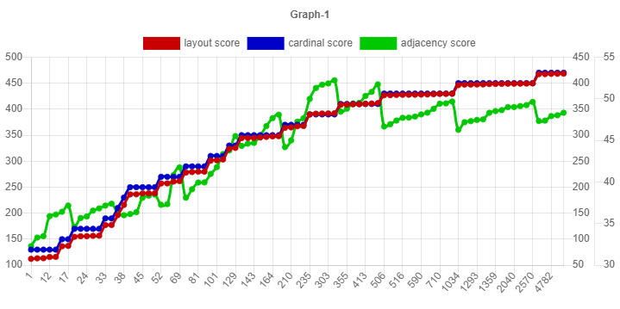
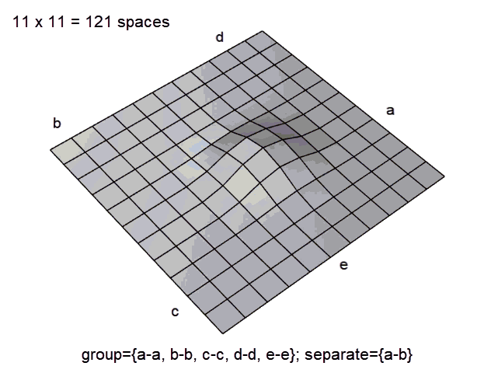
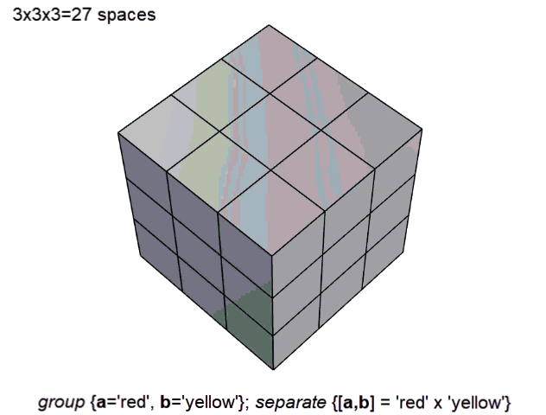
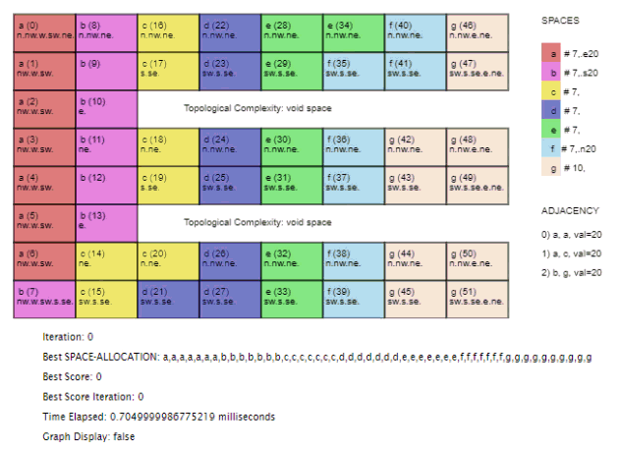
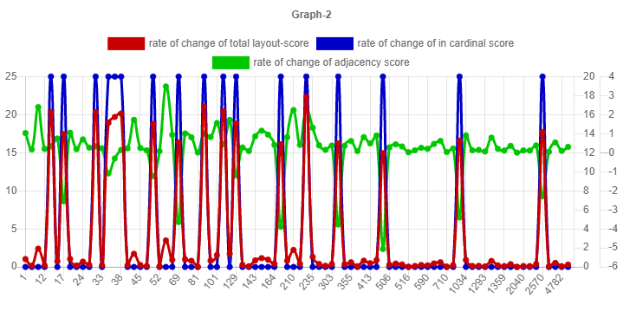
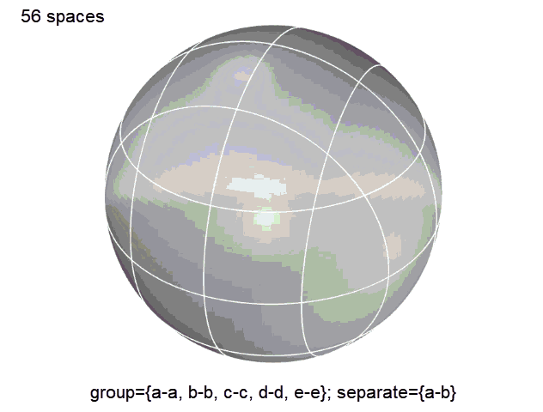
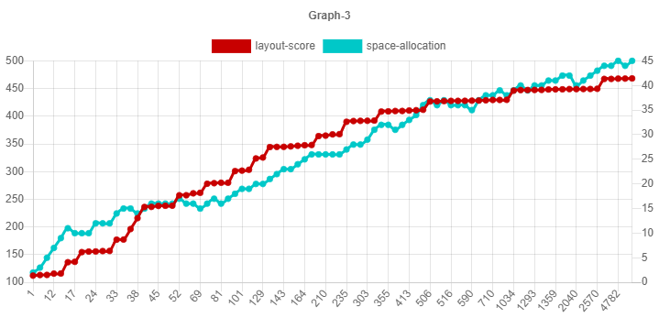
@ https://dots-ai.herokuapp.com/
Constraints in a nutshell
Adjacency
a-a,
a-c,
b-g
Orientation
a-> east
b-> south,
f-> north
Graph 1 :
layout-score
orientation-score
adjacency-score
Reinforcement Learning
Graph 2 : rate of change:
layout-score
orientation-score
adjacency-score
Graph 3 :
layout-score
change in layout

Slide 8
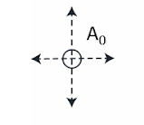
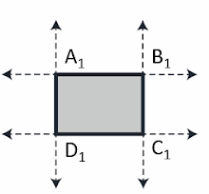
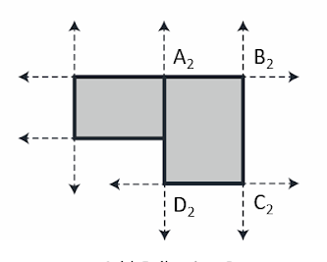
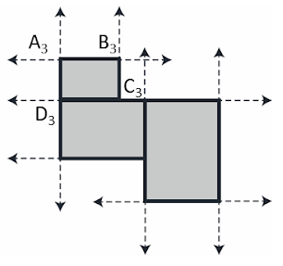
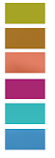
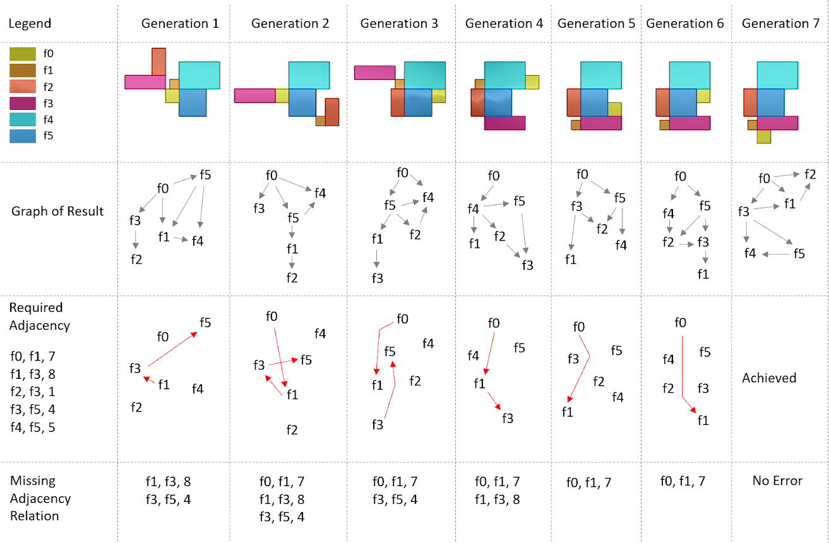
Formulation
Constraints
Name | Length | Width | F0 | F1 | F2 | F3 | F4 | F5
F0 | 100 | 100 |  | 10
F1 | 70 | 70 |  |  |  | 10
F2 | 100 | 200 |  |  |  | 10
F3 | 300 | 100 |  |  |  |  |  | 10
F4 | 300 | 200 |  |  |  |  |  | 10
F5 | 200 | 200
McMC Iterations
Representation
Backtracking

Slide 9

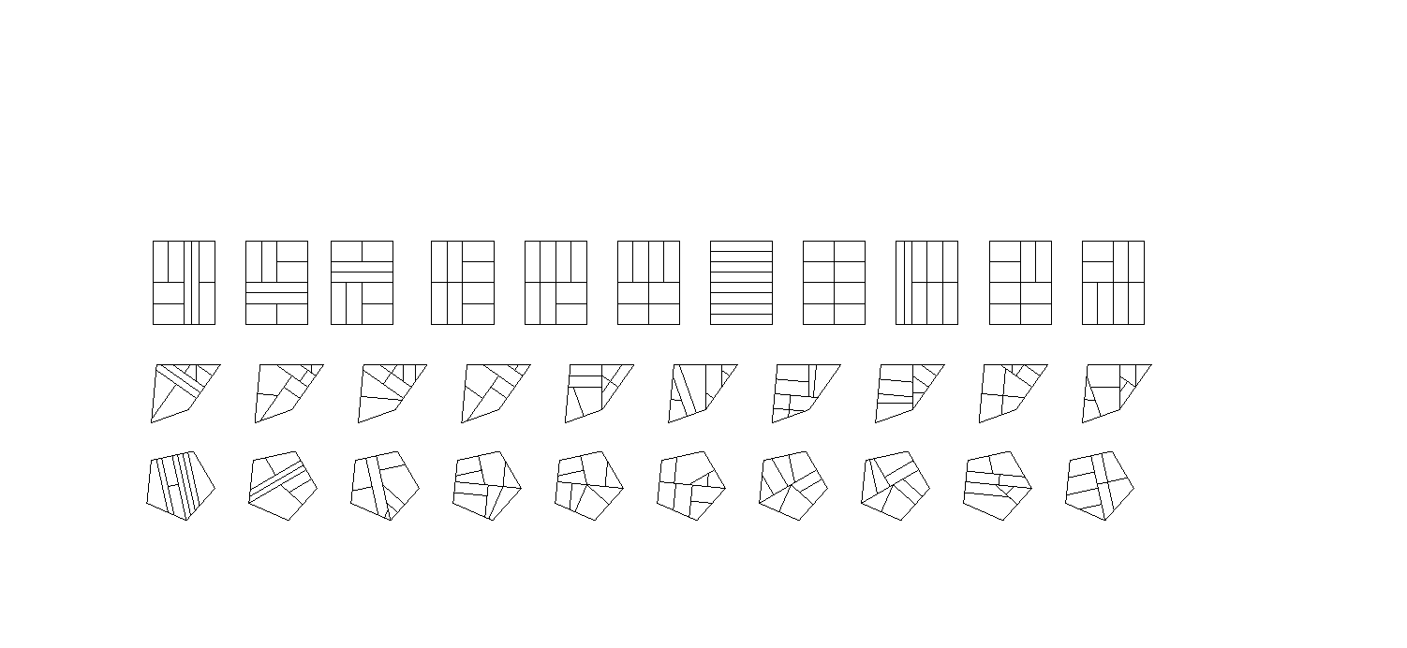



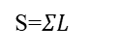
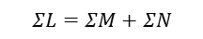

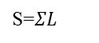
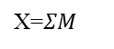
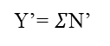
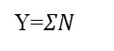
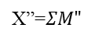
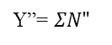
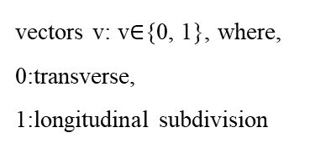
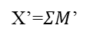
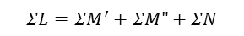
Homeomorphic Equivalence: topological & geometric operations
Binary Partition
Requirements - partitions
Geometric Equivalence
Controlling Vectors
Generalization
S=$ΣL$
vectors v: v$∈${0, 1}, where,
0:transverse,
1:longitudinal subdivision
Area=$ΣL$
L={a,b,c,d}
L={a,b,c,d}
$$ΣL=ΣM+ΣN$$
M={a,b}
N={c,d}
Y=$ΣN$
X=$ΣM$
S=$ΣL$
L={a,b,c,d}
M={a,b}
N={c,d}
X’=$ΣM$’
Y=$ΣN$
$$ΣL=ΣM^{′}+ΣM"+ΣN$$
M’={a}
M”={b}
X”=$ΣM"$
S=$ΣL$
L={a,b,c,d}
Y’= $Σ$N’
M={a,b}
N={c,d}
X’=$ΣM$’
$$ΣL=ΣM^{′}+ΣM"+ΣN′+ΣN"$$
M’={a}
M”={b}
N’={c}
N”={d}
X”=$ΣM"$
Y”= $ΣN"$
S=$ΣL$

Slide 10
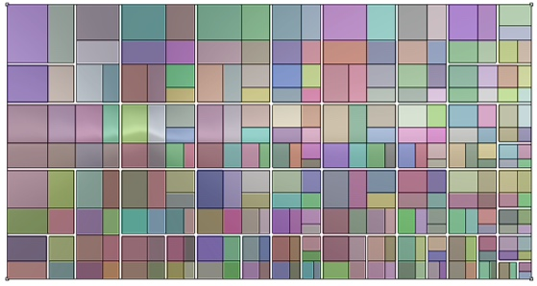
Enumerations based on isomorphisms
Generate Circulation
Left
O
Right
L= {a,b,c,…,n-1, n}
OLR
ORL
M={a,b,…g-1,g}
N={g+1,…,n-1,n}
OLL
ORL
OLR
ORR
M’={a,b,…,e-1,e}
N’={g+1,…,k-1,k}
M”={e+1,…g-1,g}
N”={k,k+1,…,n-1,n}
O
OL
OR
OLL
OLR
ORL
ORR
OLLL
OLLR
O
OL
OR
very large layouts
OLL
OLR
ORL
ORR
OLRL
OLRR

Slide 11
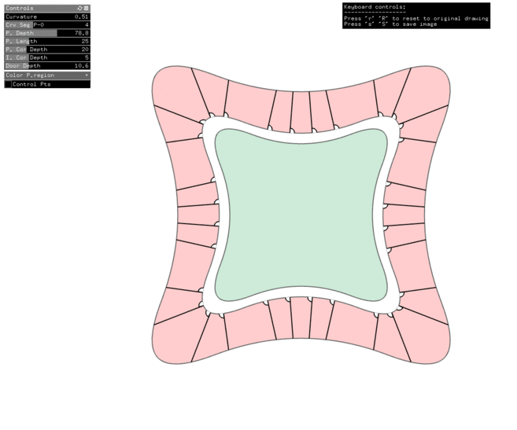
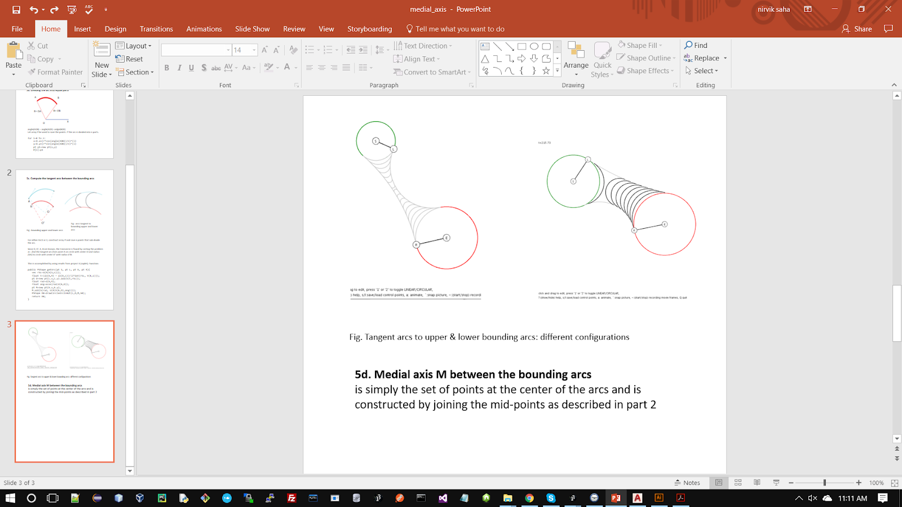
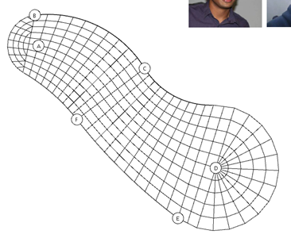
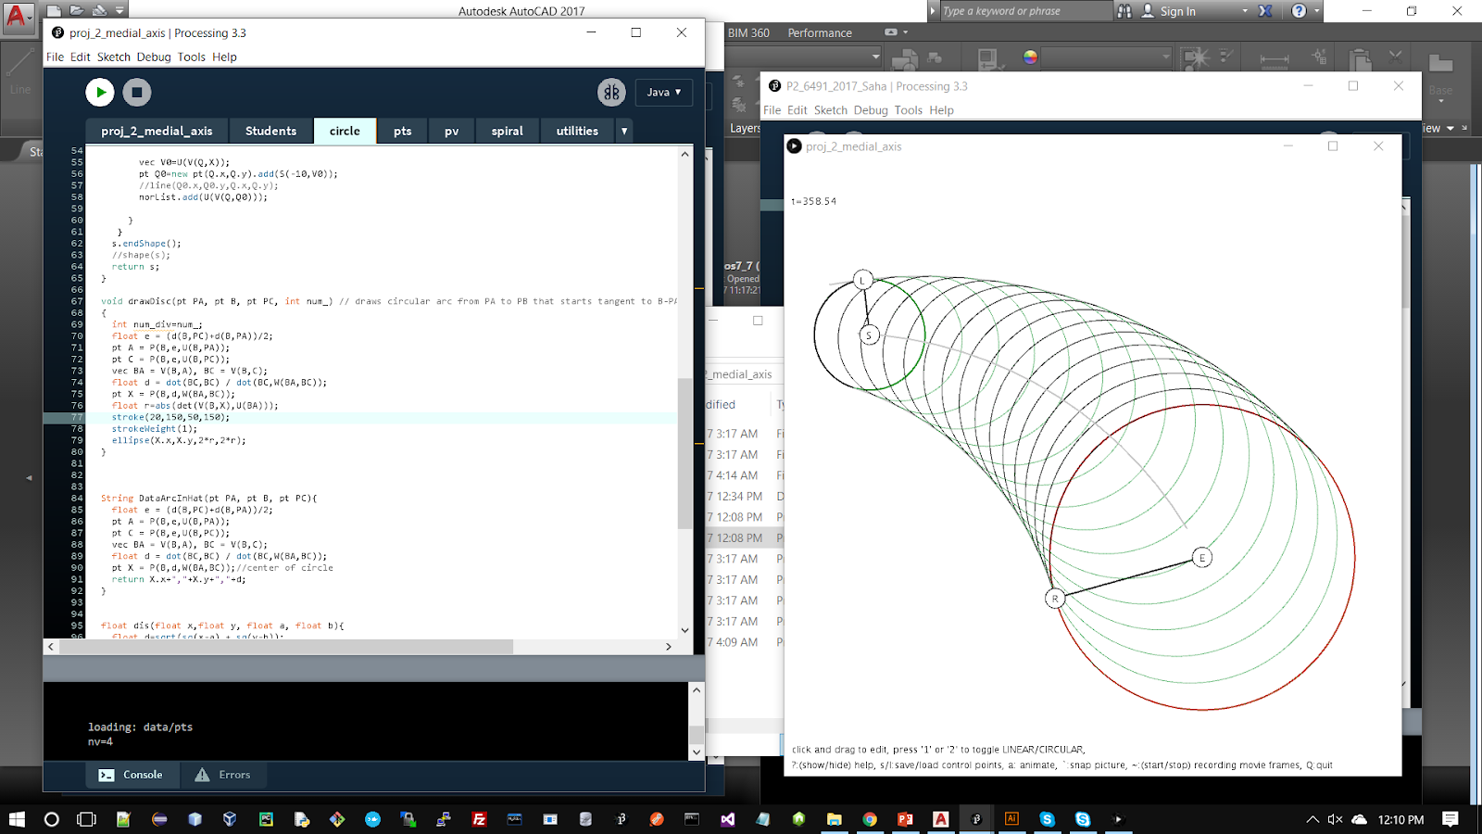
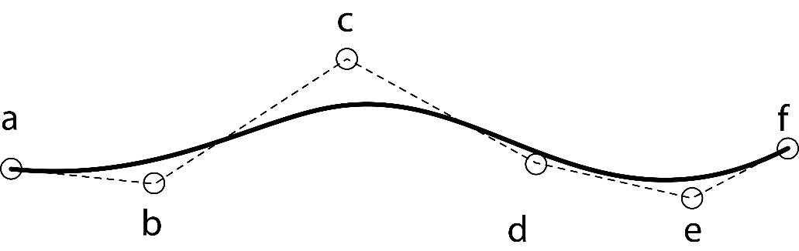
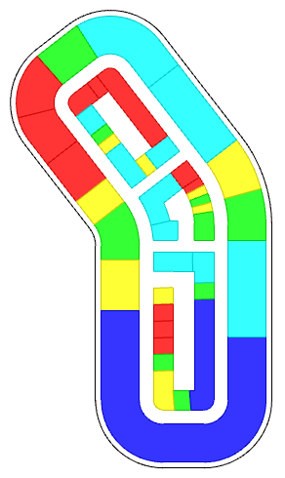
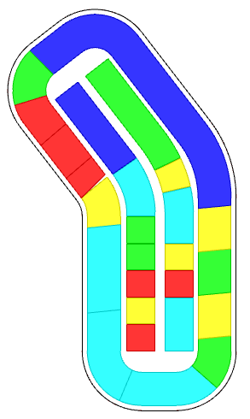
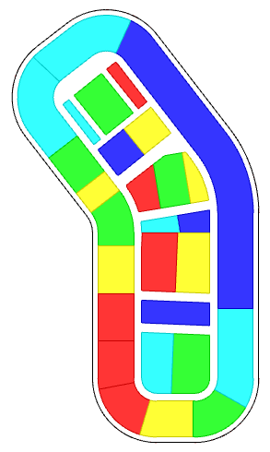
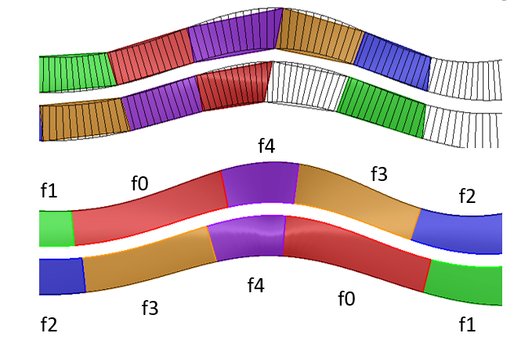
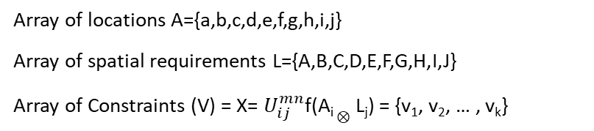
Bernstein polynomial basis recurrence relation
f(t) = Σ_{i=0}^{n} (^{n}C_{i}) (1-t)^{n-i} t^{i}
Array of locations A={a,b,c,d,e,f,g,h,i,j}
Array of spatial requirements L={A,B,C,D,E,F,G,H,I,J}
Array of Constraints (V) = X= $U_{ⅈj}^{mn}$f(A_{i} $⊗$ L_{j}) = {v₁, v₂, … , v_{k}}
spaces | Area | Depth | Number | rgb | f0 | f1 | f2 | f3 | f4
f0 | 1000 | 100 | 2 |  |  |  |  | 50
f1 | 300 | 100 | 2 |  |  | -50
f2 | 500 | 100 | 2 |  |  |  | -50
f3 | 850 | 100 | 2 |  |  |  |  | 50
f4 | 350 | 100 | 2 |  |  |  |  |  | 100
Medial Axis Transform
peripheral
longitudinal
transverse

Slide 12
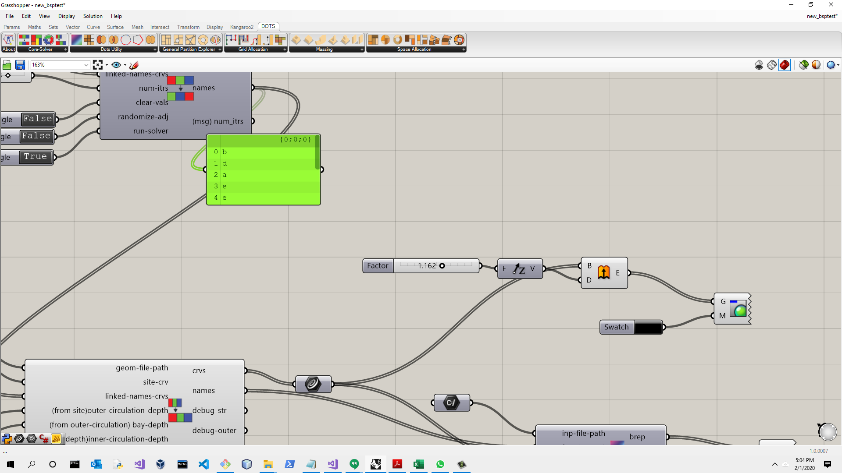







DOTS for project-specific site-plan to floor-plan = WORKFLOW
Result of operations
start
DOTS notation
end

Slide 13





User-friendly access to algorithms
Geometry Inputs
Name | Key | Area |  | Number
name_A | a | 500 |  | 2
name_B | b | 500 |  | 4
name_C | c | 1500 |  | 2
name_D | d | 750 |  | 4
name_E | e | 2000 |  | 5
Adjacency Inputs
Name | Key | a | b | c | d | e
name_A | a | 100 |  | 10
name_B | b |  | 10
name_C | c | 10
name_D | d |  |  |  | -50
name_E | e
Attract:
a-a
a-c
b-b
e-e
Repel:
d-d
Inputs
Initial Configuration
Optimization
Updated result

Slide 14


User-friendly access to algorithms
Step 3: Adjacency Matrix
Name | Key | a | b | c | d | e
name_A | a | 100 |  | 10
name_B | b |  | 10
name_C | c | 10
name_D | d
name_E | e
Attract:
a-a
a-c
b-b
Step 4: Adjacency Matrix
Name | Key | a | b | c | d | e
name_A | a | 100 |  | 10
name_B | b |  | 10
name_C | c | 10
name_D | d |  |  |  | -50
name_E | e
Attract:
a-a
a-c
b-b
Repel:
d-d

Slide 15



Space Planning
Generalize / flexibility
Memory functions

Slide 16











DOTS for floor plan workflow
Generalize: topological variations
DOTS notation
<4 threads>
<4 threads>
List of requirements: Neuro Patient Room, Patient Room, Ada Patient Room, Conference, Training Room, Neuro Monitor Room, Reading, Interview Room, Ptot Therapy, EVS, Consult, Seating Area, Family Lounge, Staff Lounge, Workstation, Meds, Clean Supplies, Staircase, Nour, EVS, Linen, Shared Office, Public Tlt, IS, Dir Office, Trash Recycle, Pts, Elec, Treatment Room, Respite Room, Food Gallery

Slide 17





DOTS for site feasibility study
DOTS ontology
Building Details, proximity / distance matrix
Name & Identification |  | Geometric Constraints |  |  |  | Distance Constraints
Name | Key | Number | Footprint Area | Fsr | Ratio | a | b | c | Color
name_A | a | 2 | 100 | 0.5 | 0.75 | 12 | 12 | 5
name_B | b | 1 | 100 | 0.2 | 1.25 | 5
name_C | c | 3 | 100 | 0.2 | 0.75 | 5 |  | 12
name_D | d | 2 | 100 | 0.35 | 1.25 | 5
The distance matrix performs is similar to the adjacency matrix, unspecified values are assumed as 0
Activity Details
Identifier |  | Location Constraints |  | Building Identifier
Name | Key | Percentage | Height | Parent | Parent | Parent | Parent | Color
name_P | p | 20 | 50 | a | b | c | d
name_Q | q | 70 |  | a | c
name_R | r | 10 | 200 | a | b
Since the activity is allocated after placing the buildings, the parents are used to identify the building.

Slide 18




Grid
Network
Circulation
Buildings / Space Allocation
from region enclosed by a curve
Connect nodes with edges
Edges- TYPES of geometry of streets, roads
centrality, dispersal, betweenness, attraction, edge-intersections
Places
Live
Shop, recreate
Work
Exit
Node type: GCN
Node type: NCN
Node type: RCN
Node type: EVAC
Edge type: Green
Edge type: Neutral path
Edge type: Road
Edge type: Intersection
Edge type: MST path
Edge type: Evacuation
Entanglement

Slide 19



Node type: GCN
Node type: NCN
Node type: RCN
Node type: EVAC
Live
Shop, recreate
Work
Exit
Edge type: Green
Edge type: Neutral path
Edge type: Road
Edge type: Intersection
Edge type: MST path
Edge type: Evacuation

Slide 20










Interoperability: Rhino - cloud (web app) - Dynamo
Cloud - mLab, Heroku (web)
Software Pipeline
https://dots-web.herokuapp.com/
Rhino3d, Grasshopper
Dynamo/Revit (BIM)
https://github.com/nirvik00/DOTS
https://github.com/nirvik00/DotsDynamoDll
User’s Software

Slide 21


Relationship
Constraints
Design Alternatives
Energy Plus Simulation (honeybee)
Energy
Solar harvesting Potential (ladybug)
Daylighting
Radiance (honeybee)
Multi-variate Regression
Openness
Sky view factor (ladybug)
Rezzae et. al., 2020;
Response | Predictor Variables
 | Number of Buildings | Number of thermal zones | Coverage Ratio | External wall area | Floor area ratio | Sky-view Factor | R² Value
Sky-view factor | ✓ | ✓ | ✓ | ✓ | ✓ | Х | 0.894
Potential solar power | ✓ | Х | Х | ✓ | Х | ✓ | 0.952
Energy Demands | Х | Х | Х | ✓ | Х | ✓ | 0.94
Energy Balance | ✓ | ✓ | Х | Х | Х | ✓ | 0.956
Chang et. al., 2019;

Slide 22


Slide 23
Data-driven, “thoughtful”
design solutions
SAT
Sources of Information & Data
Complimentary Platform
integrated logic
explicit design workflows
Semi-Automation
Performance Measurements
Spatial-temporal data
Origin-destination studies
Real time data
FOR a given scheme: energy analysis, daylighting,
of tourists, places of interest, visited,
from IoT devices and smart city platforms
GIS, mobile, tracking devices
local spikes in travels
amenity requirements
Recommendation Systems
process guidance
inference-based

Slide 24
Technologies
Dots Plugin for Rhino/Grasshopper | https://github.com/nirvik00/DOTS
Dots-web (cloud service) | https://dots-web.herokuapp.com/
Dots Plugin for Dynamo BIM | https://github.com/nirvik00/DotsDynamoDll
Plugs-web solver | https://plugs-web.herokuapp.com/
Reinforcement learning illustrated | https://dots-ai.herokuapp.com/
Applications: Games using AI/ML | https://ai4dots.herokuapp.com/
Frameworks & Programming Languages used for prototyping | C++, C#, Python, JS, Openframeworks, Processing, Three.JS, Rhino-common API, Dynamo API, NodeJS, MongoDB, Tensorflow (Heroku+MongoDB Atlas)
Thank you

